Slide 1
ARTIFICIAL INTELIGENCE
COURSE INSTRUCTORS:
EVANS TETTEH OWUSU
HEANAMPONG CLEMENT

Slide 2
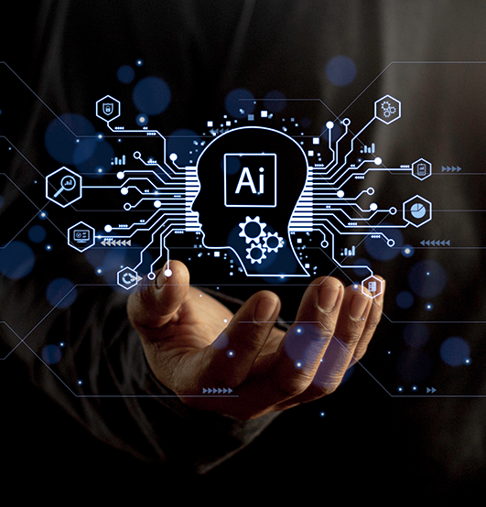
What is Ai?
AI is a new technical science that studies and develops theories, methods, techniques, and application systems for simulating and extending human smartness.

Slide 3
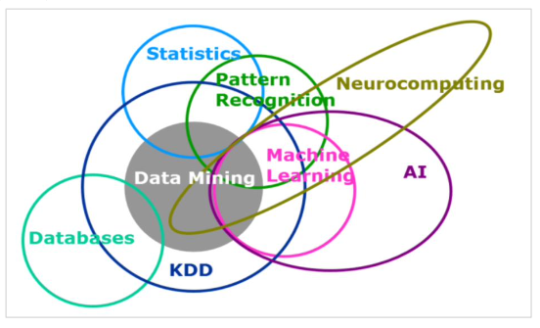
In 1956, the concept of
AI was first proposed by John McCarthy, who defined the subject as "science and
engineering of making intelligent machines, especially intelligent computer program".
The purpose of AI is to make machines intelligent and give them human thoughts
"I propose to consider the question, 'Can machines think?’”
- Alan Turing in 1950
"The science of making machines do things that would require smart if done by men.”
- Marvin Minsky in 1972

Slide 4
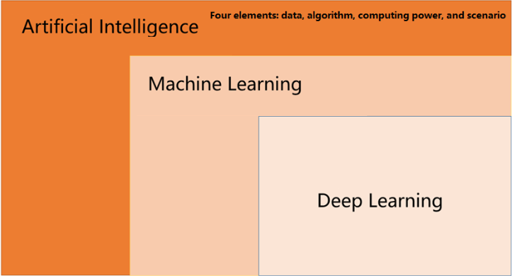
Machine learning is specialized in studying how computers simulate or implement human
learning behaviour to acquire new knowledge or skills. The concept of Deep Learning
originates from the research on Artificial Neural Networks (ANNs). Deep learning is a
new field in machine learning that simulates the human brain to interpret data such as
images, sounds, and texts.
Among the three, machine learning is a way or subset of AI, and deep learning is a
special type of machine learning. AI can be compared to the brain. Machine learning is a
process of mastering cognitive capabilities, and deep learning is an efficient teaching
system in this process. AI is the goal and the result. Deep learning and machine learning
are methods and tools.

Slide 5
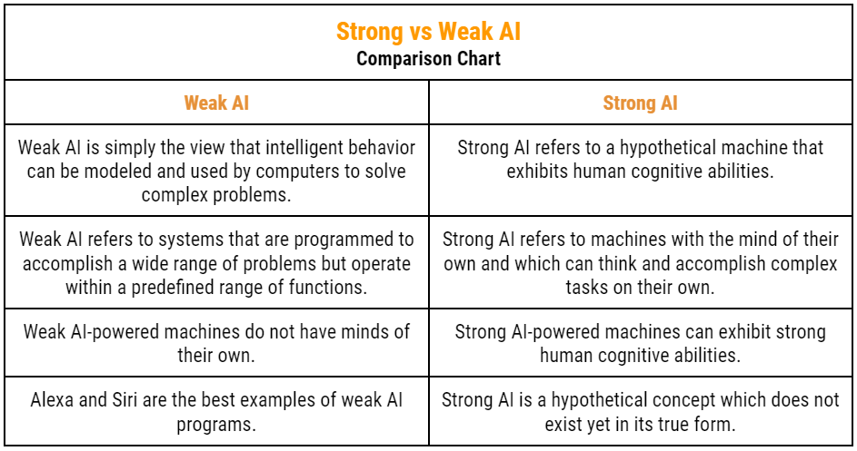
TYPES OF AI

Slide 6
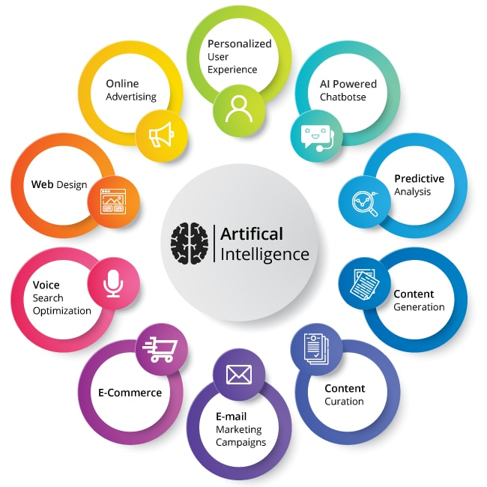
APPLICATION FIELDS OF AI
Computer Vision
Natural Language Processing
Speech processing

Slide 7
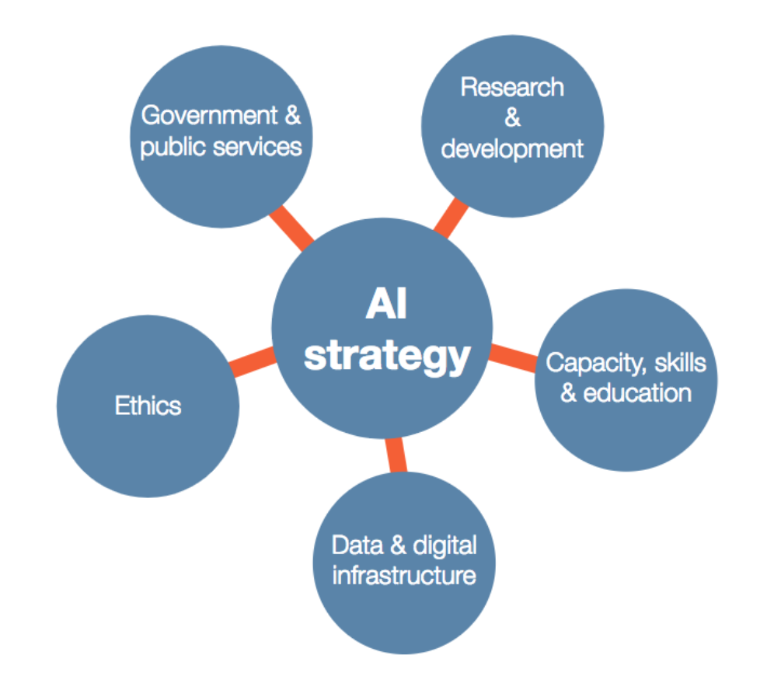
AI DEVELOPMENT STRATEGY
An AI development strategy is a plan that integrates artificial intelligence (AI) into an organization's business operations. The goal is to improve efficiency, customer experience, and innovation.

Slide 8
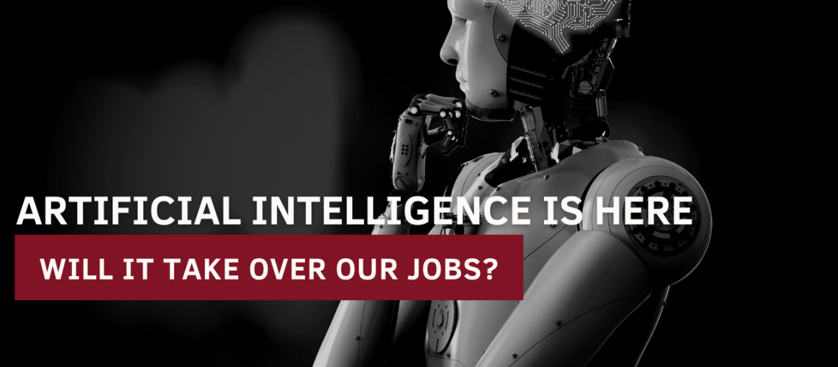
CONTROVERSIES OVER AI

